Slide 1
Feature Extraction in
Automatic Speech Recognition
Jeih-weih Hung, July 3, 2001

Slide 2

Outline
Introduction
Speech Production
Speech Perception
Speech Signal Analysis : Feature Extraction
  Mel-Frequency Cepstral Coefficients (MFCC)

Slide 3
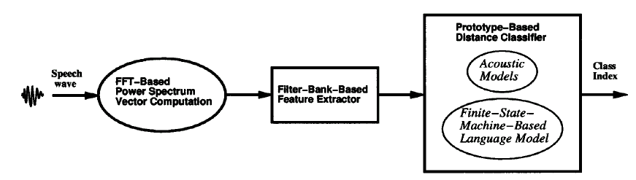
Introduction
A Current Speech Recognition System is mainly composed of :
  a front-end feature extractor (feature extraction module)
    required to discover salient characteristics suited for classification
    based on scientific and/or heuristic knowledge about patterns to recognize
  a back-end classifier (classification module)
    required to set class boundaries accurately in the feature space
    statistically designed according to the fundamental Bayes decision theory

Slide 4
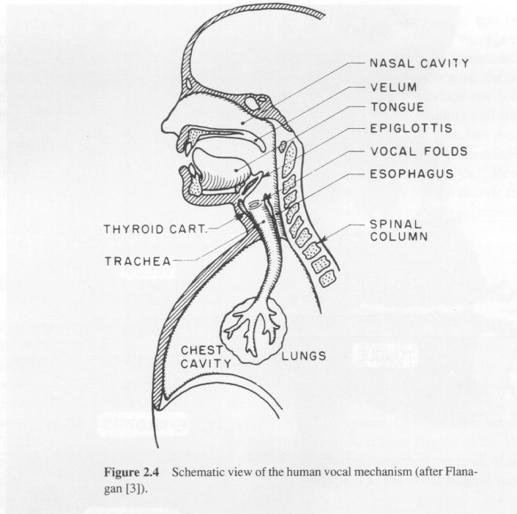
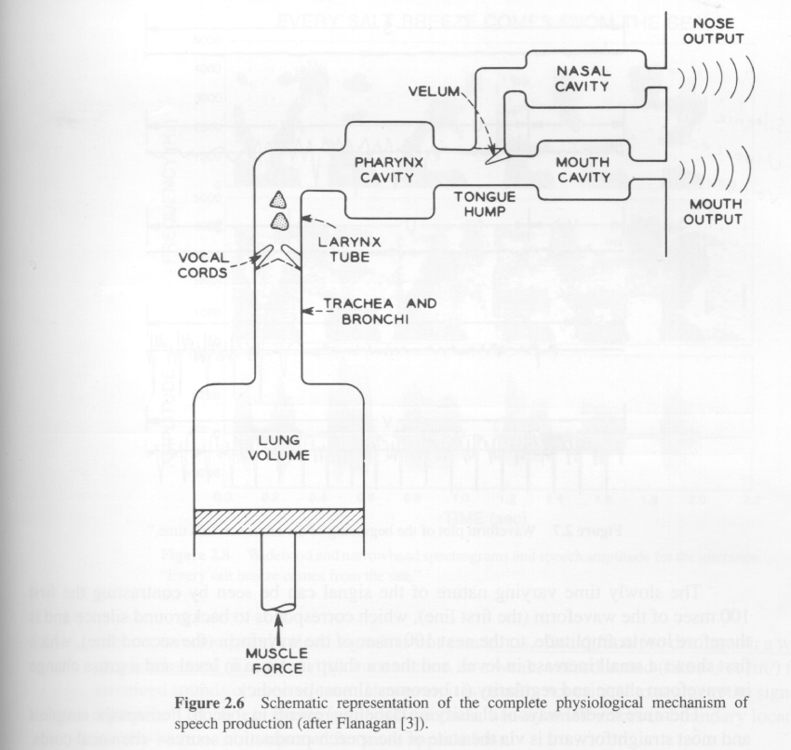
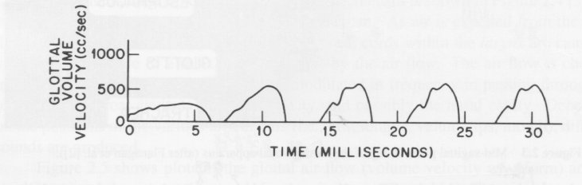
Speech Production
Schematic view of the human vocal mechanism
Schematic representation of the complete
physiological mechanism of speech production
Glottal volume velocity
(excitation)

Slide 5




Speech Production
Sophisticated model for sound production
Simplified model for sound production
Voiced
Pitch period, P
Gain
DT
Impulse
Generator
G(z)
Glottal
filter
Voiced/unvoiced
switch
u(n)
Voice
volume
velocity
H(z)
Vocal Tract
Filter
R(z)
Lip
Radiation
Filter
s(n)
Speech
Signal
V
Uncorrelated
Noise
Generator
U
Gain
Unvoiced
Pitch period, P
Voiced
DT
Impulse
Generator
Voiced/unvoiced
switch
All-pole
Filter
s(n)
Speech
Signal
V
White
Noise
Generator
U
Gain
Unvoiced

Slide 6
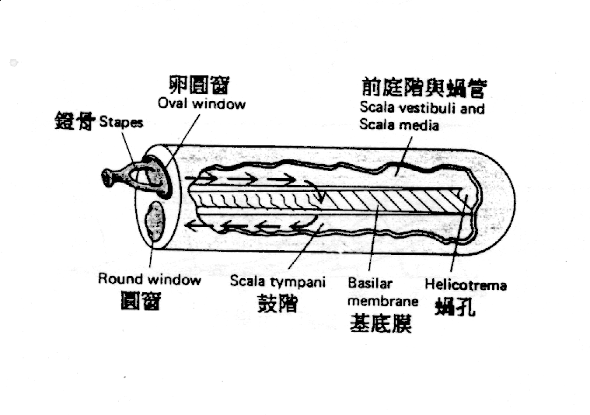
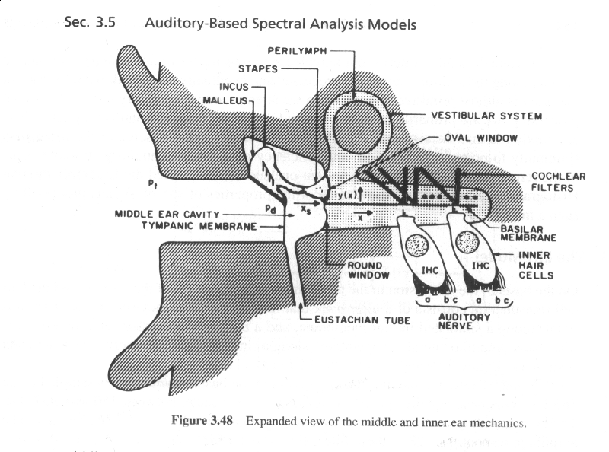
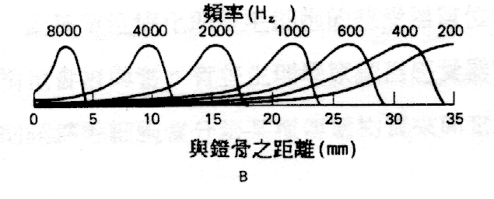
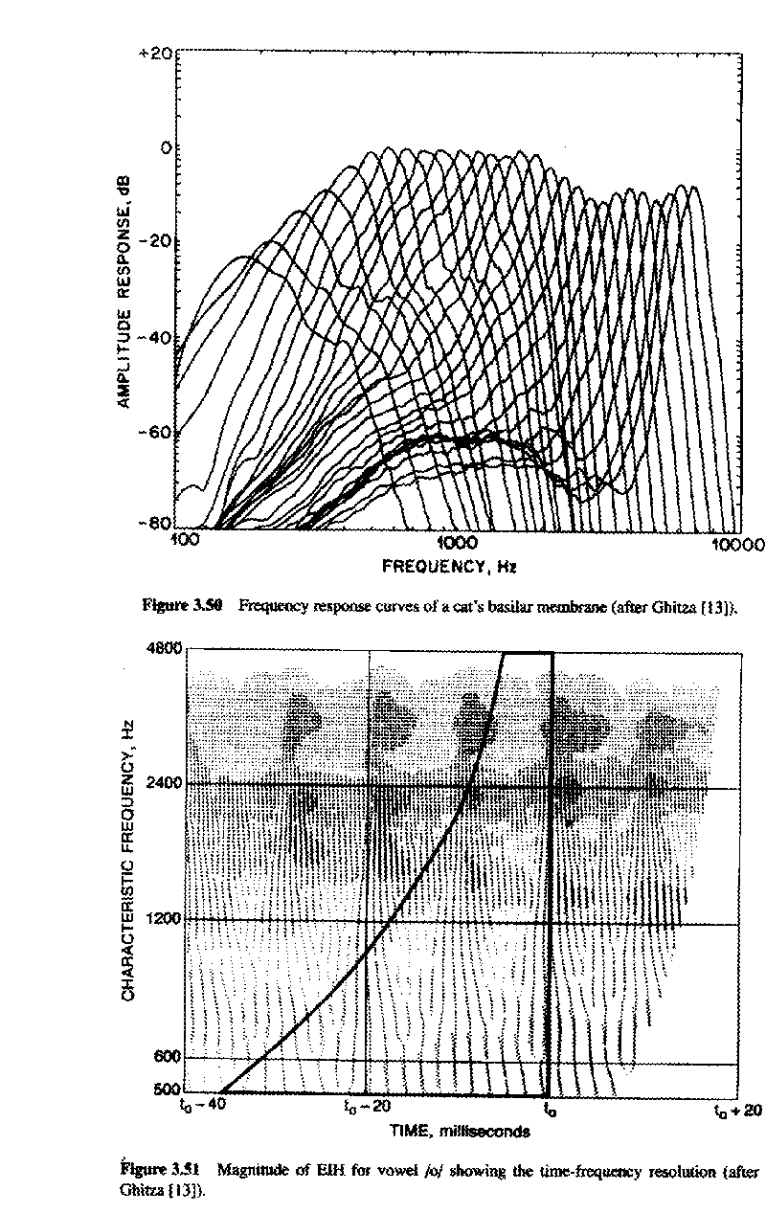
Speech Perception
Middle and inner ear mechanics

Slide 7
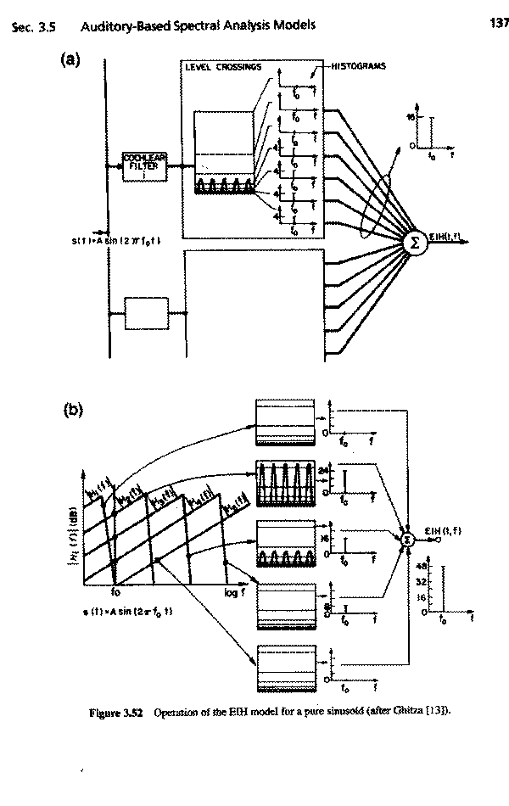
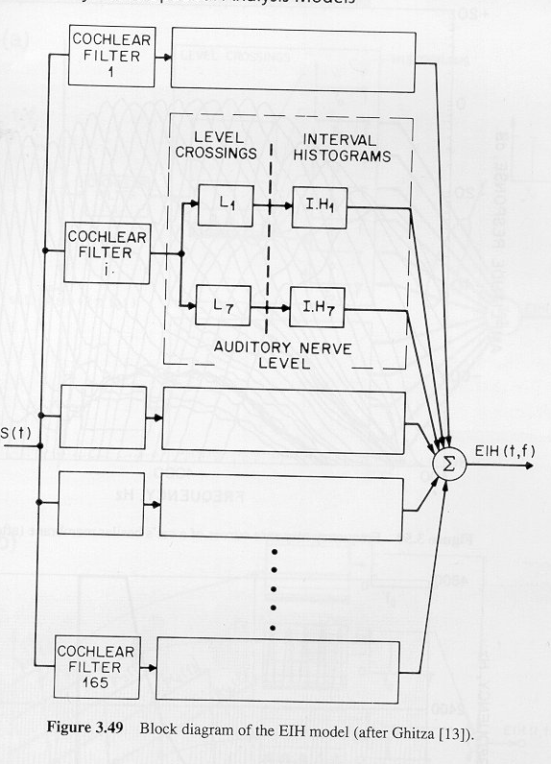
Speech Perception
EIH (Ensemble Interval Histogram) model
Level Crossing Detector
log scale
combine histograms
across all channels

Slide 8
Speech Signal Modeling : Feature Extraction
Three Main Driving Forces
Perceptually Meaningful Parameters
  Parameterizations are sought that represent salient aspects of the speech signal....
  Preferably parameters that analogous to those used by human auditory system.....perceptually meaningful
Robust Parameters
  Parameterization are desired that are robust to variations in channel, speaker, and transducer
Time-Dynamic Parameters
  Parameters can capture spectral dynamics, or changes of the spectrum with time ....temporal correlation problem

Slide 9
Speech Signal Modeling : Feature Extraction
Spectral Shaping
  A/D conversion
    Conversion of the signal from a sound pressure wave to a digital signal
Digital Filtering
  Emphasizing important frequency components in the signal
perceptually meaningful !
LPC
FFT
PLP
MFCC.....
Maximize recognition
performance
Parameterization

Slide 10
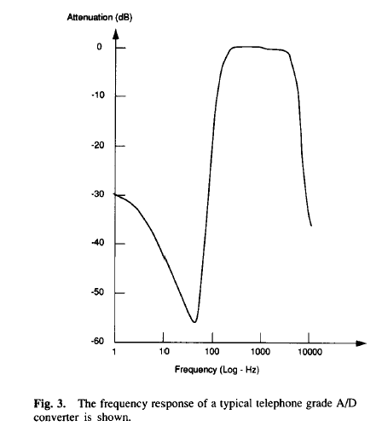
Speech Signal Modeling : Feature Extraction
Problems for A/D Converter
  Frequency Distortion (50-60-Hz
  hum).
  Nonlinear Input-Output Distortion.
  Example
    Frequency response of a typical
    telephone grade A/D converter
    The sharp attenuation of low
    frequency and high frequency
    response causes problem for
    subsequent parametric spectral
    analyses algorithms
The Most Popular Sample Frequency
  Telecommunication: 8kHz
  Non-telecommunication: 10~16kHz

Slide 11
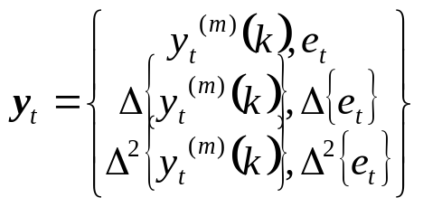
Feature Extraction : MFCC
Mel-Frequency Cepstral Coefficients (MFCC)
  Most widely used in the speech recognition
  Has generally obtained a better accuracy and a minor computational complexity
  The scheme of MFCC processing :
Speech signal
x_{t}(n)
X_{t}(k)
Mel
filter banks
Pre-emphasis
DFT
x(n)
x’(n)
Window
Y_{t}(m)
energy
Log(| |²)
e_{t}
derivatives
y_{t} ^{(m)}(k)
Y_{t}’(m)
IDFT
MFCC

Slide 12
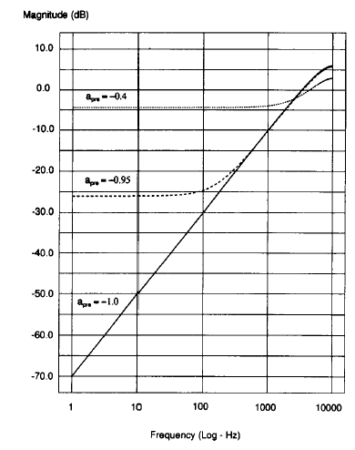
Feature Extraction : Pre-emphasis
The process of Pre-emphasis :
  a high-pass filter
Speech signal x(n)
x’(n)=x(n)-ax(n-1)
H(z)=1-a • z⁻¹ 0<a≤1

Slide 13
Why pre-emphasis? (1)
Reason 1: Physiological Characteristics
  The minimum-phase component of the glottal signal can be modeled by a simple two-real-pole filter whose poles are near z=1
  The lip radiation characteristic, with its zero near z=1, tends to cancel the spectral effects of one of the glottal pole
  ==> By introducing a second zero near z=1 (pre-emphasis), can eliminate effectively the larynx and lips spectral contributions.
  =>Analysis can be asserted to be seeking the parameters corresponding to the vocal tract only
Reason 2: Prevent Numerical Instability
  If the speech signal is dominated by low frequencies, it is highly predictable and a large LP model will result in an ill-conditioned autocorrelation matrix

Slide 14
Why pre-emphasis? (2)
Reason 3 :
  Voiced sections of the speech signal naturally have a negative spectral slope (attenuation) of approximately 20 dB per decade due to physiological characteristics of the speech production system
  High frequency formants have small amplitude with respect to low frequency formants. A pre-emphasis of high frequencies is therefore require to obtain similar amplitude for all formants
Reason 4 :
  Hearing is more sensitive above the 1 kHz region of the spectrum

Slide 15
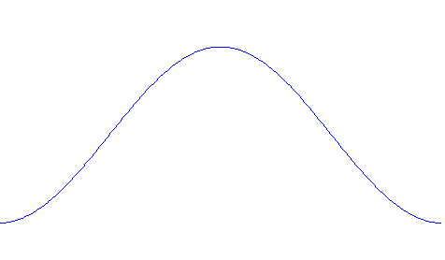
Feature Extraction : Windowing
The process of windowing : frames
Frame-based
overlapping
Hamming window

Slide 16
Why Windowing? (1)
Why separating the signal into successive and overlapping frames?
  Traditional methods for spectral evaluation are reliable in the case of a stationary signal (i.e., a signal whose statistical characteristics are invariant with respect to time)
    For voice, this holds only within the short time intervals of articulatory stability
Frames
  Frame Duration (T_{f}) : the length of time over which a set of parameters is valid. Frame duration ranges between 20 ~ 10 ms
  Frame Period: the length of time between successive parameter calculations
  Frame Rate: the number of frames computed per second

Slide 17
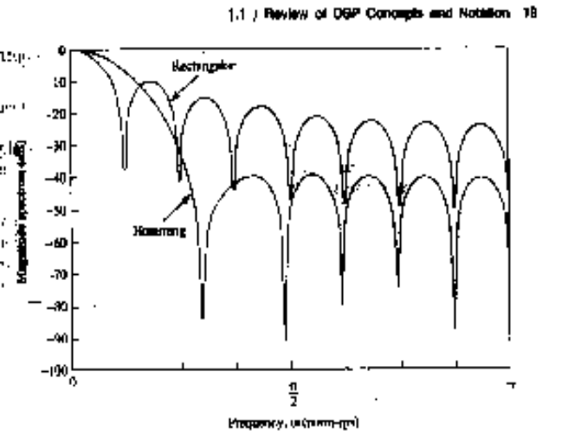
Why Windowing? (2)
Windowing :
  x_{t}(n)=w(n)•x’(n), w(n): the impulse response of the window
    Frequency response : X_{t}(f)=W(f)*X’(f), *: convolution
  Ideally, w(n)=1 for all n , whose frequency response is just an impulse
    This is invalid since the speech signal is stationary only
    within the short time intervals
  Rectangular window (w(n)=1 for 0≤n<1):
    just extract the frame part of signal without further processing
    Whose frequency response has high side lobes
  Main lobe : spreads out in a wider frequency
  range the narrow band power of the signal,
  and thus reduces the local frequency
  resolution
  Side lobe : swap energy from different
  and distant frequencies of x’(n),
  which is called leakage

Slide 18
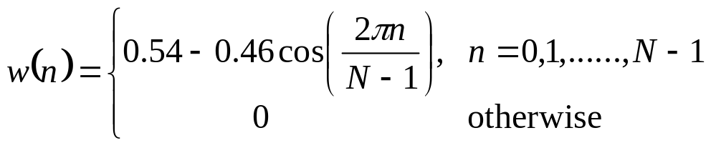
Why Windowing? (3)
Windowing (Cont.):
  For a designed window, we wish that
    the main lobe is as narrow as possible in its width
    the side lobe is as lower as possible in its magnitude
      However, this is a trade-off!
  The most-used window shape is the Hamming window, whose impulse response is a raised cosine impulse:

Slide 19
Feature Extraction : DFT and Mel-filter bank processing
For each frame of signal (N points, e.g., N=512),
  the Discrete Fourier Transform (DFT) is first performed to obtain its spectrum (M points, for example M=512)
  The bank of filters according to Mel scale is then performed, and the each filter output is the sum of its filtered spectral components (K filters, and thus K points, for example K=24)
sum
Y_{t}(1)
f
Time domain signal
spectrum
sum
Y_{t}(2)
t
DFT
f
f
x_{t}(n)
X_{t}(k)
sum
Y_{t}(K)
f

Slide 20
Why Filter-bank Processing?
The filter-bank processing simulates human ear processing
  Center frequency of each filter :
    The position of maximum displacement along the basilar membrane for stimuli such as pure tone is proportional to the logarithm of the frequency of the tone
  Bandwidth :
    Frequencies of a complex sound within a certain bandwidth of some nominal frequency cannot be individually identified.
    When one of the components of this sound falls outside this bandwidth, it can be individually distinguished.
    This bandwidth is referred to as the critical bandwidth.
    A critical Bandwidth is nominally 10% to 20% of the center frequency of the sound

Slide 21
Why Filter-bank Processing?
For Speech Recognition Purpose :
  Filters are non-uniformly spaced along the frequency axis.
  The part of the spectrum below 1kHz is processed by more filter banks
    This part contains more information on the vocal tract such as the first formant
  Non-linear frequency analysis is also used to achieve frequency/time resolution
    Narrow band-pass filters at low frequencies enables harmonics to be detected
    Longer bandwidth at higher frequencies allows for higher temporal resolution of bursts

Slide 22
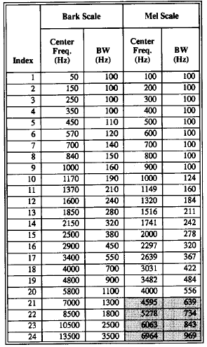
Why Filter-bank Processing?
The most-used two warped frequency scale : Bark scale and Mel scale

Slide 23
Feature Extraction : Logarithmic operation and IDFT
The final process of MFCC construction : logarithm operation and IDFT
Mel-filter output
spectral vector Y_{t}
Filter index
Log(| |²)
Log-spectral vector Y’_{t}
Filter index
IDFT
y_{t}=CY’_{t}
MFCC vector y_{t}
quefrency

Slide 24
Why Log Energy Computation?
Using the magnitude (energy) only since …..
  Phase information is useless in speech recognition
    Replacing the phase part of the original speech signal with continuous random phase won’t be perceived by human ear
Using the Logarithmic operation since ……
  The logarithm of the spectrum has the effect of reducing the component amplitudes at every frequency, which is a characteristic of the human hearing system
  It performs a dynamic compression, making feature extraction less sensitive to variations in dynamics
  In order to separate more easily the excitation produced by the vocal cords and the the filter that represents the vocal tract
    Speech signal x(n), excitation v(n) and the impulse response of vocal tract h(n)
    x(n)=v(n)*h(n) ➔X(ω)=V(ω)H(ω)
    ➔ |X(ω)|=|V(ω)||H(ω)| ➔log|X(ω)|=log|V(ω)|+log|H(ω)|

Slide 25
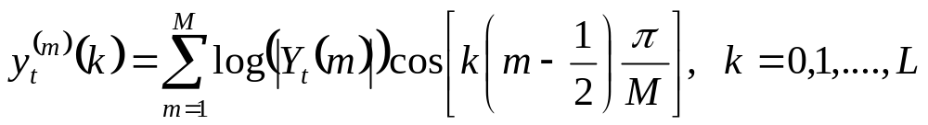
Why Inverse DFT?
Final procedure for MFCC : performing the inverse DFT on the log-spectral power
Great advantages :
  Since the log-power spectrum is real and symmetric, the inverse DFT reduces to a Discrete Cosine Transform (DCT). The DCT has the property to produce more highly uncorrelated features y_{t} than log(|Y_{t}|)
  Cepstral coefficients are more compact since they are sorted in variance order
    can be truncated to retain the highest energy coefficients, which represents an implicit liftering operation with a rectangular window
  Successfully separates the vocal tract and the excitation
    The envelope of the vocal tract changes slowly, and thus at low quefrencies (lower order cepstrum), while the periodic excitation are at high quefrencies (higher order cepstrum)

Slide 26
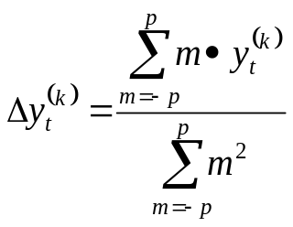
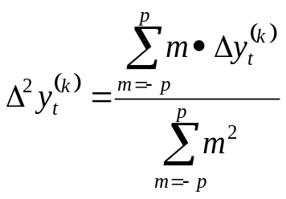
Feature Extraction : Derivatives
Derivative operation : to obtain the temporal information of the static feature vector
n-1 n n+1 n+2
quefrency
MFCC stream y_{t}
Frame index
quefrency
ΔMFCC stream Δy_{t}
Frame index
quefrency
Δ² MFCC stream Δ²y_{t}
Frame index

Slide 27
Why Delta coefficients?
To capture the dynamic evolution of the speech signal
  Such information carries relevant information for speech recognition
  The distance (the value of p) should be taken into account since …..
    Too low distance may imply too correlated frames and therefore the dynamic cannot be caught
    Too high values may imply frames describing too different states
To cancel the DC part (channel effect) of the MFCC features
  For example, for clean speech, the MFCC stream is
  {y(t-N), y(t-N+1),…....,y(t), y(t+1), y(t+2), ……},
  while for a channel-distorted speech, the MFCC stream is
  {y(t-N)+h, y(t-N+1)+h,…....,y(t)+h, y(t+1)+h, y(t+2)+h, ……}
  the channel effect h is eliminated in the delta (difference) coefficients

Slide 28
Conclusion
From this class, the following several points should be understood and memorized
  The speech is roughly the convolution of the excitation caused by the vocal chords and the impulse response of the vocal tract. The part of vocal tract is more helpful in speech recognition
    Spectral smoothing :
    remove the harmonic structure of the speech spectrum corresponding to pitch information
    obtain an envelope representation with a small number of parameters
  In the speech signal analysis, non-linear compression is often performed on both axes of the spectral representation due to the perceptual property
    frequency axis : Mel scale
    magnitude axis :logarithm (log( )), root (|E|^{γ}), lin-log (log(1+JE))
  The components of the speech feature should be as uncorrelated to each other as possible in order to be represented by a model of a simpler structure

